Slide 1
Underwater Acoustics
from Physics to AI

Slide 2
OUTLINE
I Acoustic waves
II Sea water
III Underwater acoustics: deep water
IV Inverse source problem

Slide 3
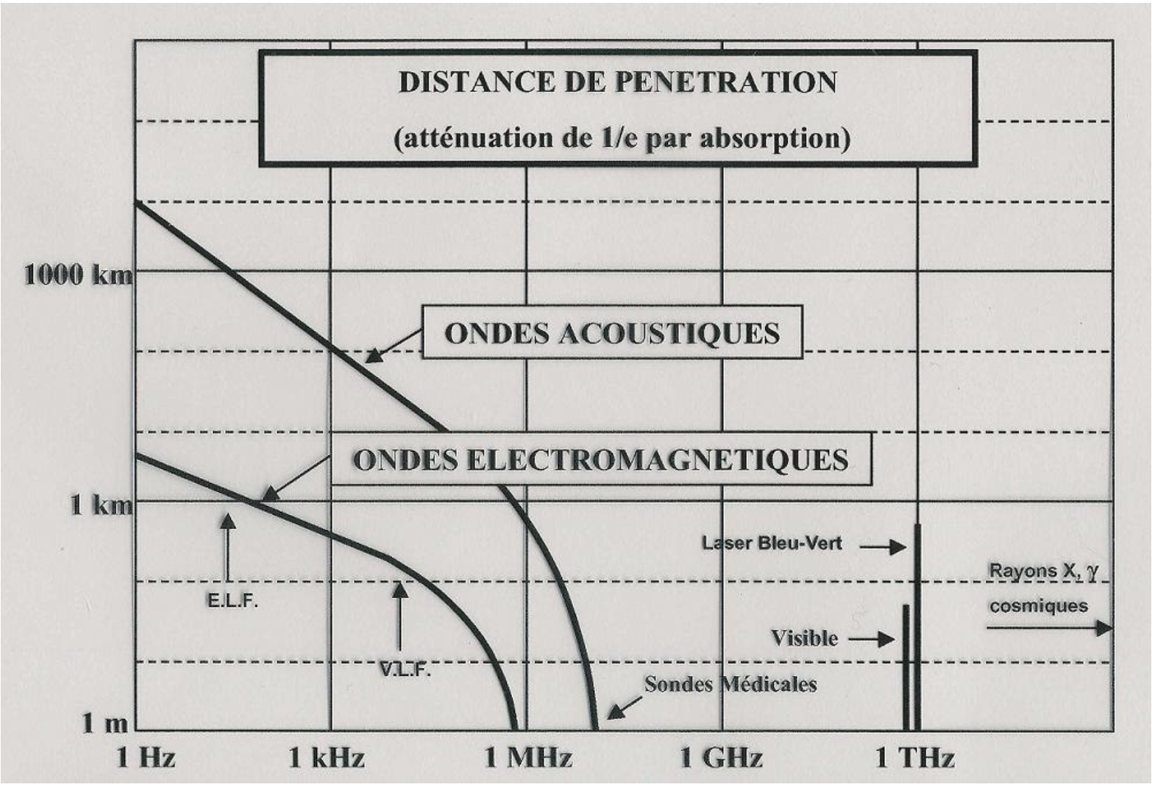
Why underwater acoustics ?

Slide 4
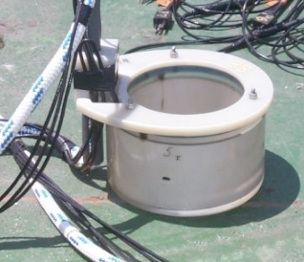
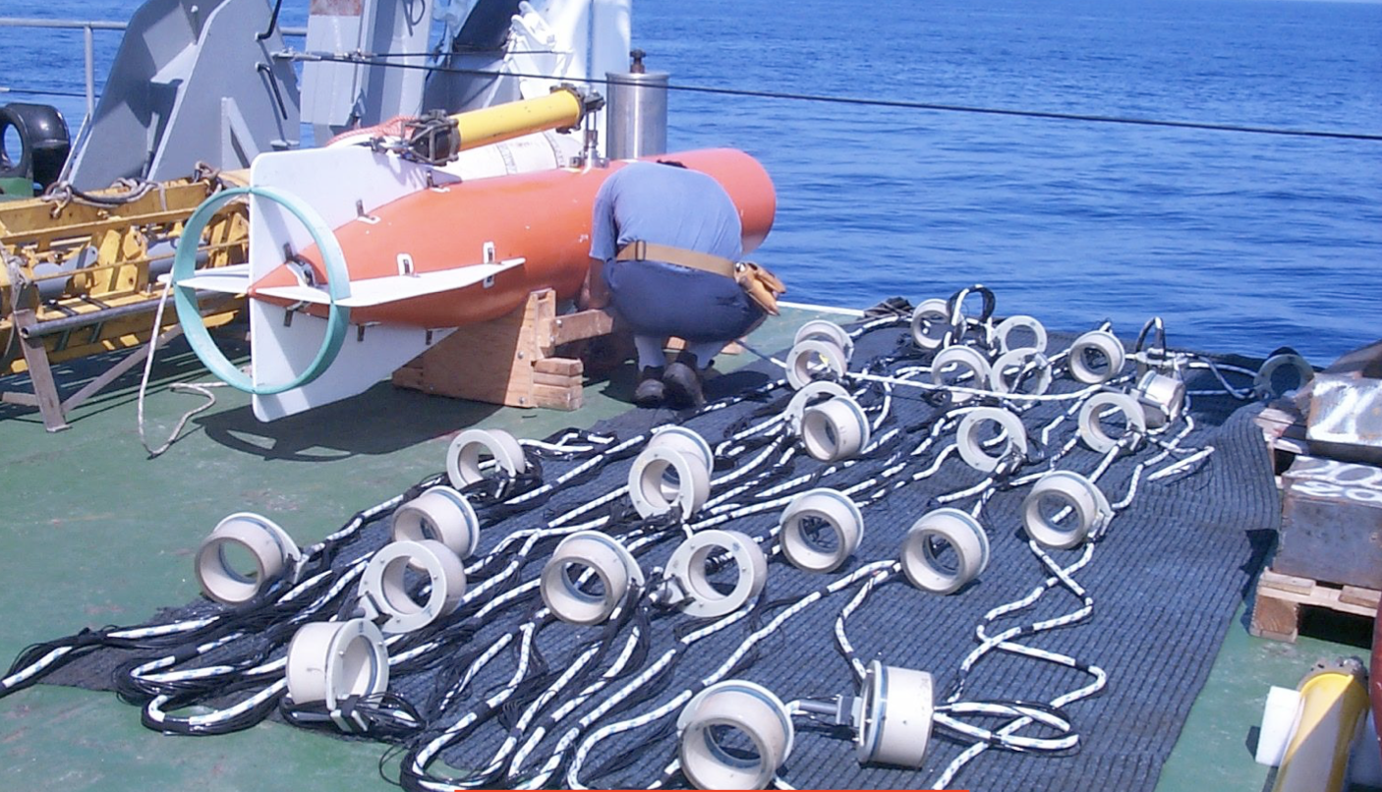
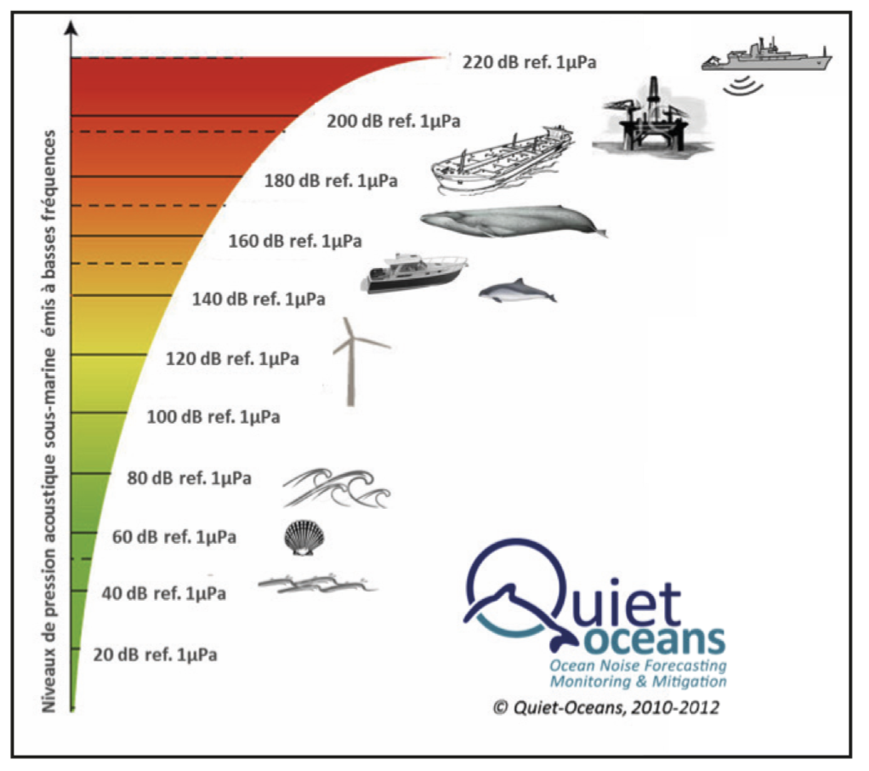

Acoustic waves
Density fluctuations remains small* (linear regime)
3.5 KHz transducers ($λ$ = 43 cm)
* with compressibility $χ$ < 10⁻⁹ Pa⁻¹, 10 bars pression wave (240 dB) leads to $\frac{δρ}{ρ}≈{10}^{−3}≈\frac{u}{c}$

Slide 5
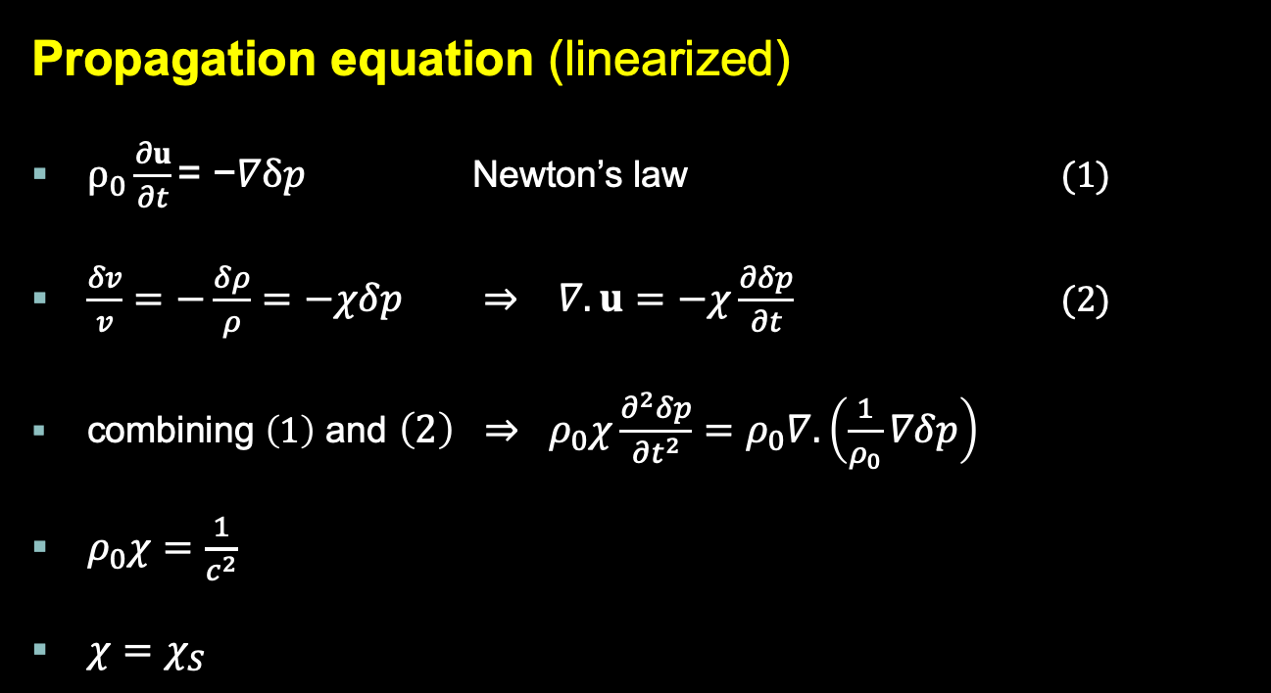
Acoustic waves
Propagation equation (linearized)
$ρ_{0}\frac{∂u}{∂t}\text{= −}∇δp$ Newton’s law (1)
$\frac{δv}{v}=−\frac{δρ}{ρ}=−χδp$ $⇒ ∇.u=$ $−χ\frac{∂δp}{∂t}$ (2)
combining $\left(1\right)$ and $\left(2\right) ⇒ ρ_{0}χ\frac{∂^{2}δp}{∂t^{2}}=ρ_{0}∇.\left(\frac{1}{ρ_{0}}∇δp\right)$
$ρ_{0}χ=\frac{1}{c^{2}}$
$χ=χ_{S}$
Notes:
Gravity is neglected in (1), as the ratio of pressure force to gravity force is 150*frequency for time harmonic wave, thus >> 1
rho_0 is the density at rest, which depends on x, y, z ; so does sound velocity c

Slide 6

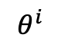

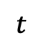

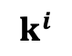
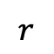

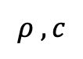
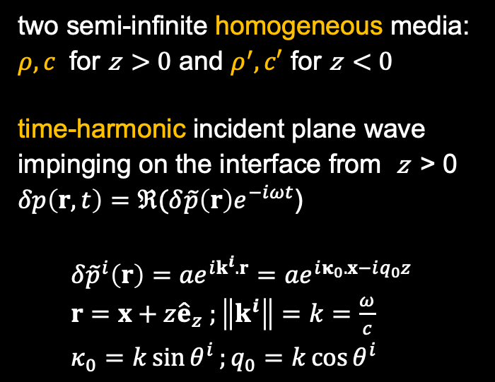
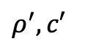
Acoustic waves
Reflexion and transmission from a flat interface
two semi-infinite homogeneous media: $ρ,c$ for z > 0 and $ρ^{′},c′$ for z < 0
time-harmonic incident plane wave impinging on the interface from z > 0
$δp\left(r,t\right)=ℜ(δ\tilde{p}\left(r\right)e^{−iωt}$)
$δ{\tilde{p}}^{i}\left(r\right)={ae}^{ik^{i}.r}=ae^{iκ_{0}.x−iq_{0}z}$
$r=x+z{\hat{e}}_{z} ;\left\|k^{i}\right\|=k=\frac{ω}{c}$
$κ_{0}=k\sin{θ^{i}};q_{0}=k\cos{θ^{i}}$
$$z$$
$$κ_{0}$$
$$k^{i}$$
$$r$$
$${−q}_{0}$$
$$θ^{i}$$
$$ρ ,c$$
$ρ^{′},c′$
$$x$$
$$t$$

Slide 7
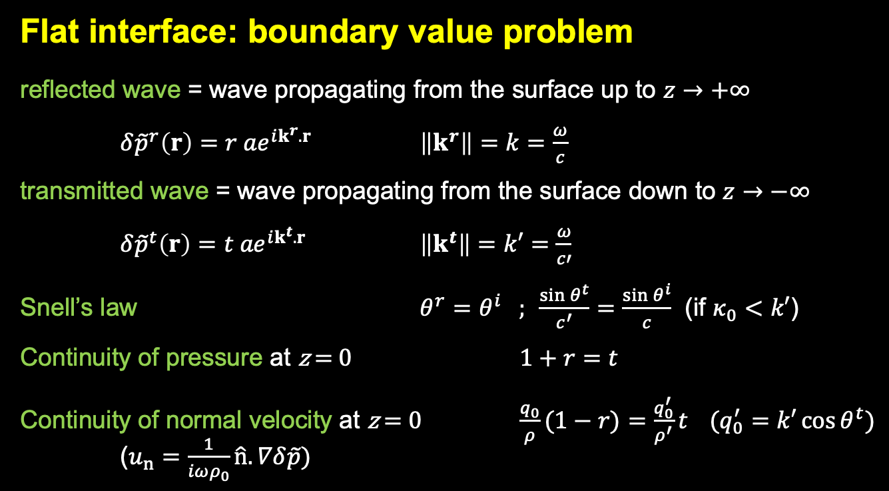
Acoustic waves
Flat interface: boundary value problem
reflected wave = wave propagating from the surface up to $z→+∞$
$δ{\tilde{p}}^{r}\left(r\right)={r ae}^{ik^{r}.r}$ $\left\|k^{r}\right\|=k=\frac{ω}{c}$
transmitted wave = wave propagating from the surface down to $z→−∞$
$δ{\tilde{p}}^{t}\left(r\right)={t ae}^{ik^{t}.r}$ $\left\|k^{t}\right\|=k′=\frac{ω}{c′}$
Snell’s law $θ^{r}=θ^{i} ;$ $\frac{\sin{θ^{t}}}{c^{′}}=$ $\frac{\sin{θ^{i}}}{c}$ (if $κ_{0}<k′$)
Continuity of pressure at z = 0 $1+r=t$
Continuity of normal velocity at z = 0 $\frac{q_{0}}{ρ}(1−r)=\frac{q_{0}^{′}}{ρ^{′}}t$ $(q_{0}^{′}=k′\cos{θ^{t}})$
($u_{n}=\frac{1}{{iωρ}_{0}}\hat{n}.∇δ\tilde{p})$

Slide 8
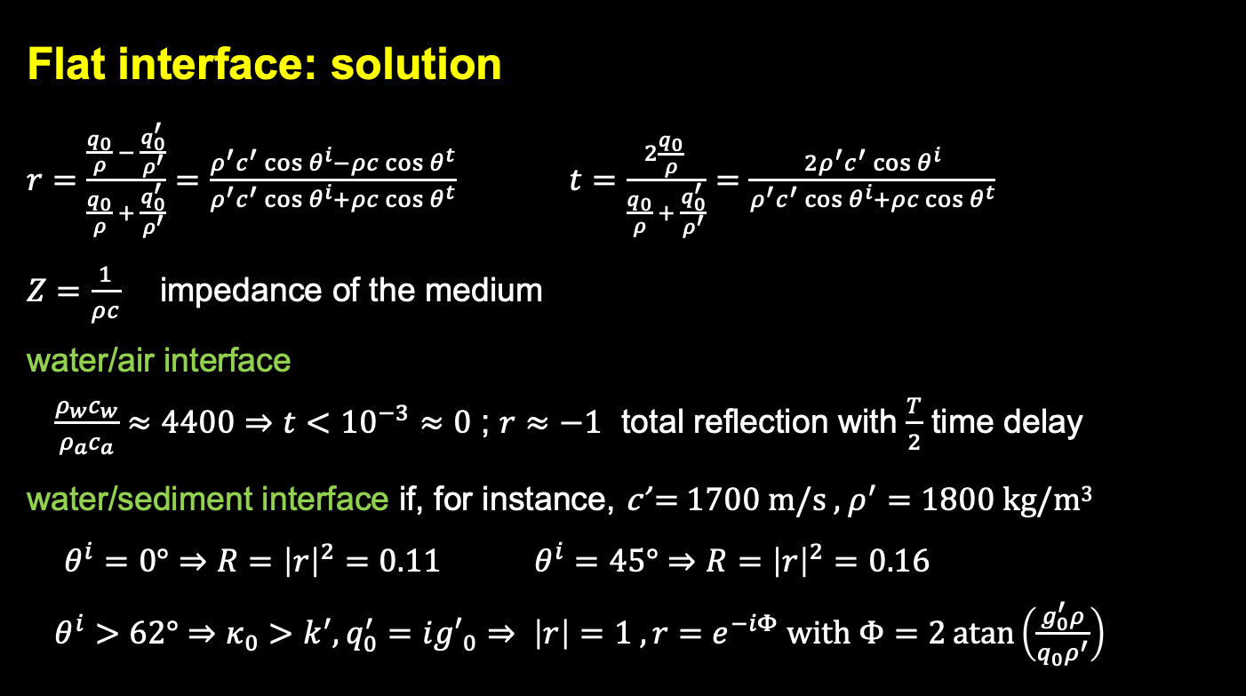
Acoustic waves
Flat interface: solution
$r=\frac{\frac{q_{0}}{ρ} − \frac{q_{0}^{′}}{ρ^{′}}}{\frac{q_{0}}{ρ} + \frac{q_{0}^{′}}{ρ^{′}}}=\frac{ρ^{′}c^{′}\cos{θ^{i}}−ρc\cos{θ^{t}}}{ρ^{′}c^{′}\cos{θ^{i}}+ρc\cos{θ^{t}}}$ $t=\frac{2\frac{q_{0}}{ρ} }{\frac{q_{0}}{ρ} + \frac{q_{0}^{′}}{ρ^{′}}}=\frac{2ρ^{′}c^{′}\cos{θ^{i}}}{ρ^{′}c^{′}\cos{θ^{i}}+ρc\cos{θ^{t}}}$
$Z=\frac{1}{ρc}$ impedance of the medium
water/air interface
$\frac{{ρ_{w}c}_{w}}{{ρ_{a}c}_{a}}≈4400⇒t<{10}^{−3}≈0$ ; $r≈−1$ total reflection with $\frac{T}{2}$ time delay
water/sediment interface if, for instance, c’ = 1700 m/s , $ρ^{′}=1800$ kg/m³
$θ^{i}=0°⇒R={\left|r\right|}^{2}=0.11$ $θ^{i}=45°⇒R={\left|r\right|}^{2}=0.16$
$θ^{i}>62°⇒κ_{0}>k^{′}, q_{0}^{′}=i{g′}_{0}⇒ \left|r\right|=1 , r=e^{−iΦ} with Φ=2\operatorname{atan}\left(\frac{g_{0}^{′}ρ}{{q_{0}ρ}^{′}}\right)$
Notes:
Phi entre 0 et pi

Slide 9
Sea water
Physical parameters
- see introduction course in oceanography
- see paper by G. Copin-Montégut (physical properties of sea water)
The density ρ is derived from salinity S, temperature t and pressure p thanks to the international State equation of sea water 1980, UNESCO (1981)
example :
S = 35, t = 10°C et p = 100 dbar, ρ = 1027,404 kg.m⁻³
The heat capacity at constant pressure, c_{p} , can be measured accurately in a laboratory and is used to derive other useful physical parameters, such as sound velocity. UNESCO publication (1983) provides an algorithm to compute c_{p} as a function of t, S and p.
Notes:
Eventuellement, fournir »Propriétés physiques

Slide 10
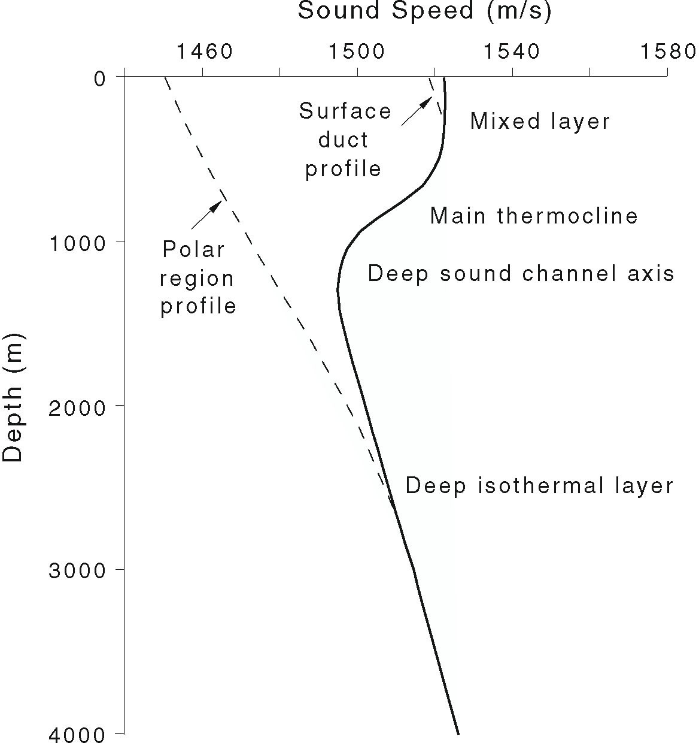
Sea water
Generic sound speed structure

Slide 11
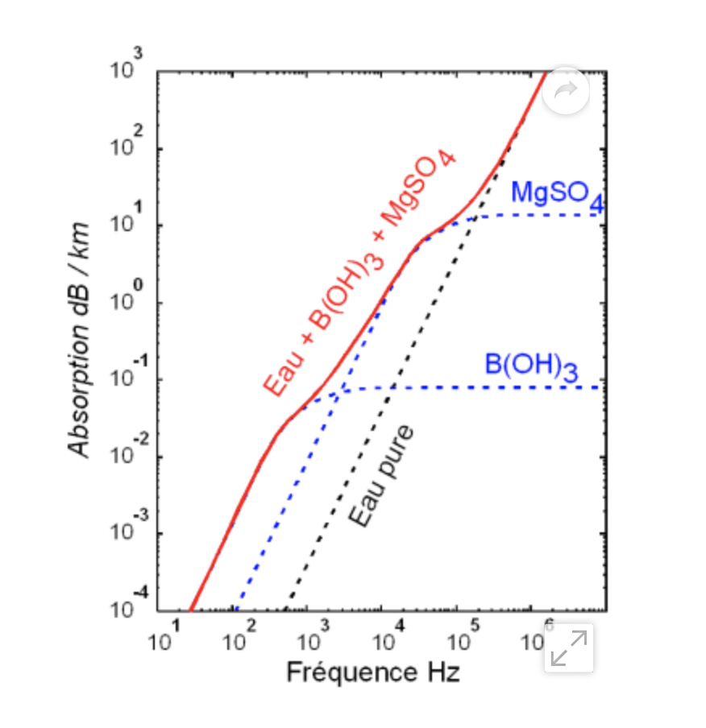
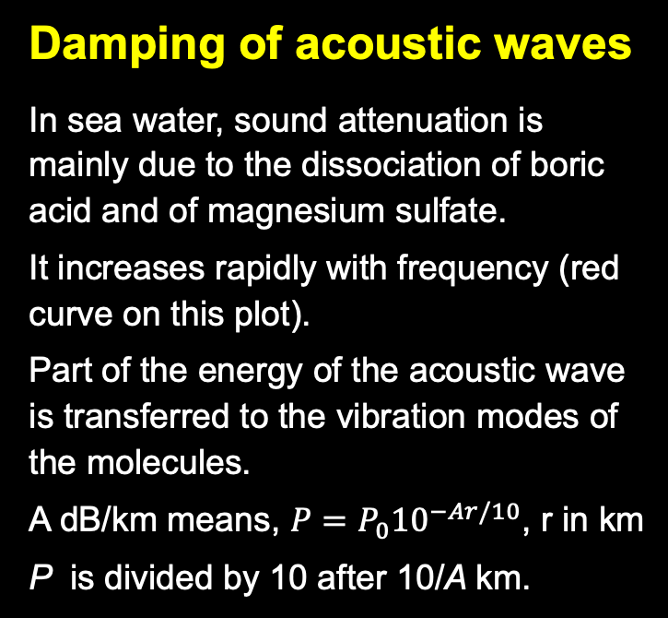
Sea water
Damping of acoustic waves
In sea water, sound attenuation is mainly due to the dissociation of boric acid and of magnesium sulfate.
It increases rapidly with frequency (red curve on this plot).
Part of the energy of the acoustic wave is transferred to the vibration modes of the molecules.
A dB/km means, $P=P_{0}{10}^{−Ar/10}$, r in km
P is divided by 10 after 10/A km.
Notes:
1 dB/km means P=P0 10^-r/10, r en km

Slide 12
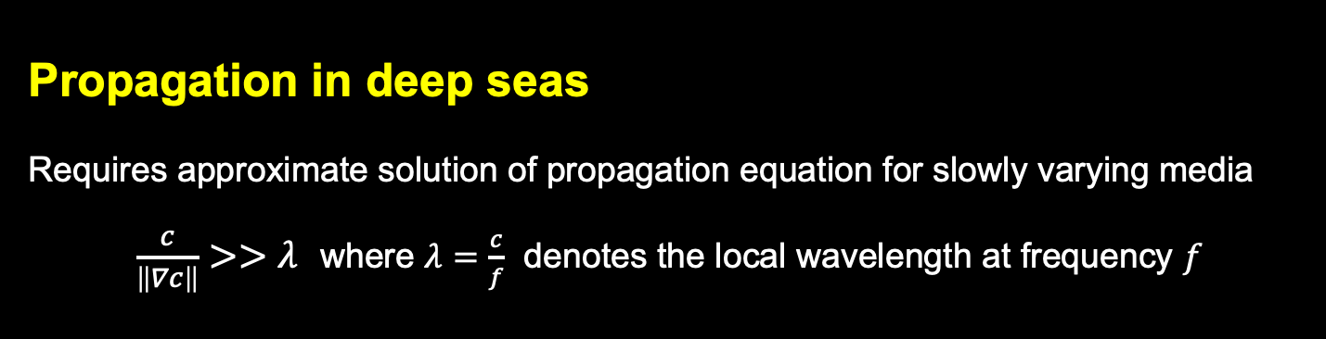



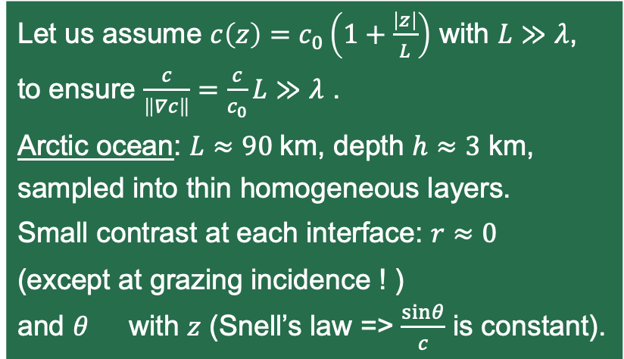
Underwater acoustics
Propagation in deep seas
Requires approximate solution of propagation equation for slowly varying media
$\frac{c}{\left\|∇c\right\|}>>λ$ where $λ=\frac{c}{f}$ denotes the local wavelength at frequency $f$
Let us assume $c\left(z\right)=c_{0}\left(1+\frac{\left|z\right|}{L}\right)$ with $L≫λ$,
to ensure $\frac{c}{\left\|∇c\right\|}=\frac{c}{c_{0}}L≫λ$ .
Arctic ocean: $L≈90$km, depth $h≈3$ km,
sampled into thin homogeneous layers.
Small contrast at each interface: $r≈0$
(except at grazing incidence ! )
and $θ$ with $z$ (Snell’s law => $\frac{sinθ}{c}$ is constant).
$$c$$
$$θ$$
$$z$$
Notes:
Cf. Jensen 2011 chap. 3 (p. 155 et suivantes)

Slide 13
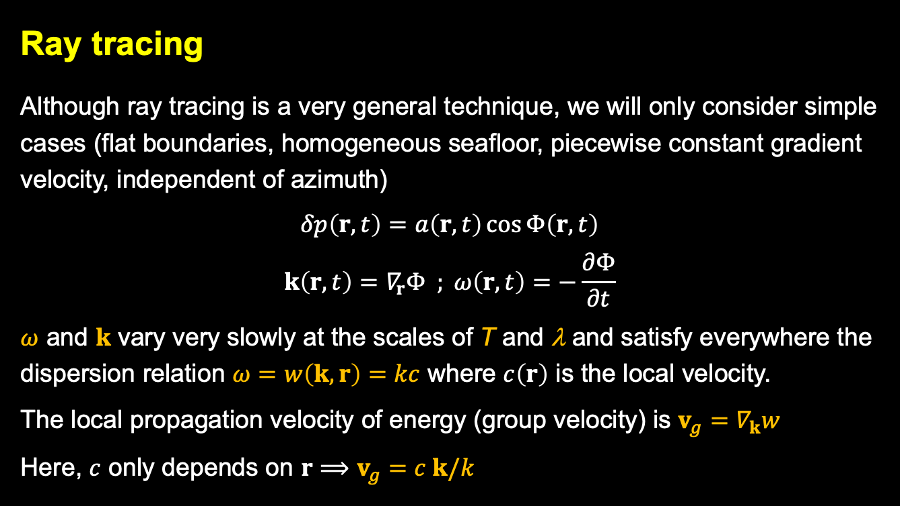
Underwater acoustics
Ray tracing
Although ray tracing is a very general technique, we will only consider simple cases (flat boundaries, homogeneous seafloor, piecewise constant gradient velocity, independent of azimuth)
$$δp\left(r,t\right)=a\left(r,t\right)\cos{Φ\left(r,t\right)}$$
$$k\left(r,t\right)=∇_{r}Φ ; ω\left(r,t\right)=−\frac{∂Φ}{∂t}$$
$ω$ and $k$ vary very slowly at the scales of T and λ and satisfy everywhere the dispersion relation $ω=w\left(k,r\right)=kc$ where $c\left(r\right)$ is the local velocity.
The local propagation velocity of energy (group velocity) is $v_{g}=∇_{k}w$
Here, $c$ only depends on $r⟹v_{g}=c k/k$
Notes:
grad_r(omega)=(grad_k(w).grad)k+grad_r(w) et grad_r(omega) = -drond k/ drond t

Slide 14
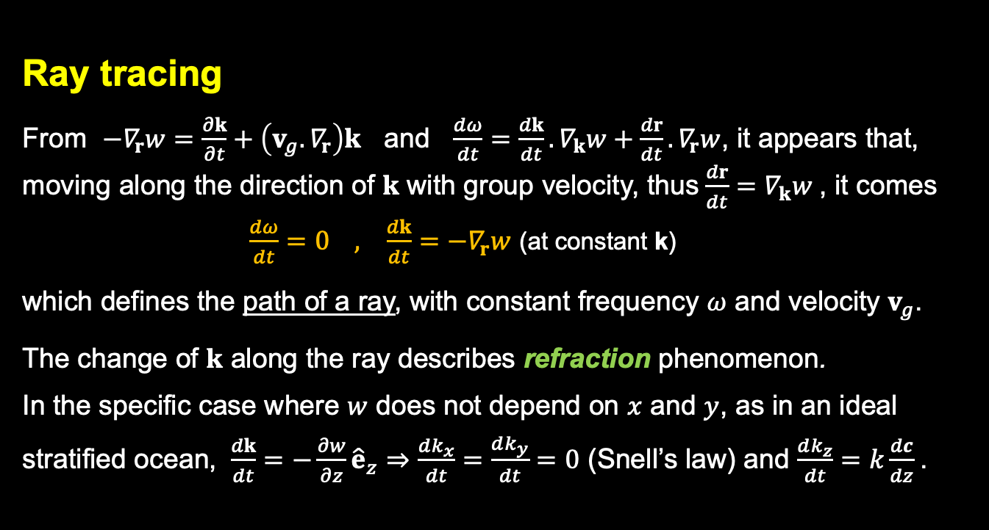
Underwater acoustics
Ray tracing
From $−∇_{r}w=\frac{∂k}{∂t}+\left(v_{g}.∇_{r}\right)k$ and $\frac{dω}{dt}=\frac{dk}{dt}. ∇_{k}w+\frac{dr}{dt}.∇_{r}w$, it appears that, moving along the direction of $k$ with group velocity, thus $\frac{dr}{dt}=∇_{k}w$, it comes
$\frac{dω}{dt}=0 , \frac{dk}{dt}=−∇_{r}w$ (at constant k)
which defines the path of a ray, with constant frequency $ω$ and velocity $v_{g}$.
The change of $k$ along the ray describes refraction phenomenon.
In the specific case where $w$ does not depend on $x$ and $y$, as in an ideal stratified ocean, $\frac{dk}{dt}=−\frac{∂w}{∂z}{\hat{e}}_{z}⇒\frac{dk_{x}}{dt}=\frac{dk_{y}}{dt}=0$ (Snell’s law) and $\frac{dk_{z}}{dt}=k\frac{dc}{dz}$.

Slide 15
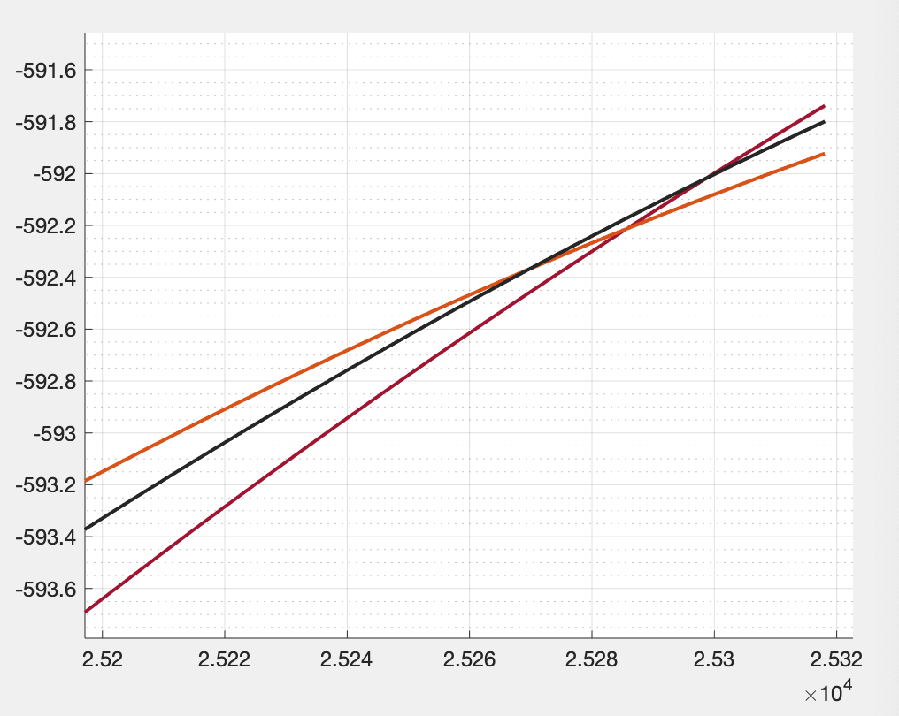
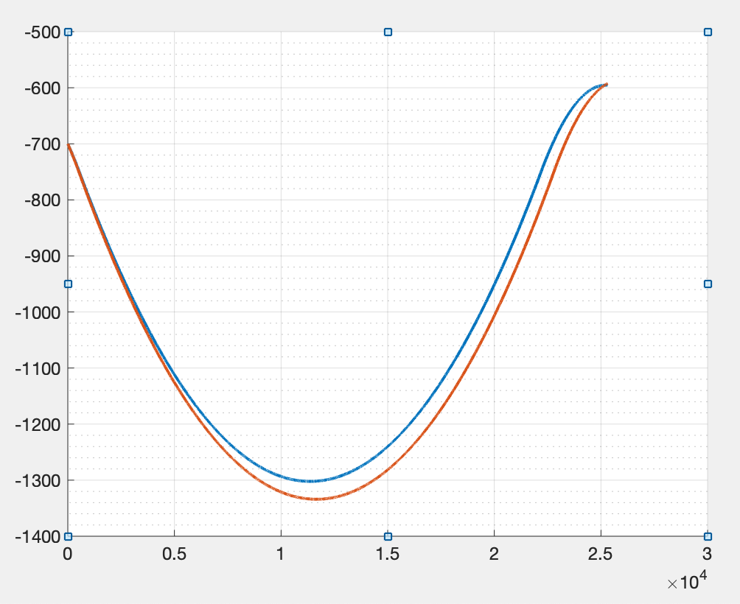

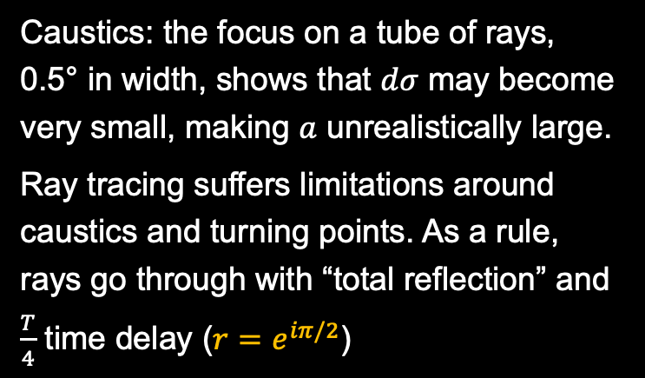
Underwater acoustics
Ray tracing
The amplitude $a$of the wave is derived from the conservation of the energy flowing through a section $dσ$of a tube of rays along the path
$\frac{a^{2}}{c}dσ=cte$
Caustics: the focus on a tube of rays, 0.5° in width, shows that $dσ$ may become very small, making $a$ unrealistically large.
Ray tracing suffers limitations around caustics and turning points. As a rule, rays go through with “total reflection” and $\frac{T}{4}$ time delay ($r=e^{iπ/2}$)

Slide 16






Underwater acoustics
Sound likes low speeds
If the gradient of the velocity is constant, the trajectory is a circle.
Denoting by $z_{S}$ the depth of the source and by $θ_{S}$ the initial direction of the ray,
the radius of the circle is
$$R=\frac{c(z_{S})}{\sin{θ_{S}}}\frac{1}{\left|{dc}/{dz}\right|}$$
and the coordinates of its center are
$x_{C}=R\cos{θ_{S}}$ ; $z_{C}=z_{S}−\frac{c(z_{S})}{{dc}/{dz}}$
The curvature is, upwards if $\frac{dc}{dz}>0$
downwards if $\frac{dc}{dz}<0$
$$c_{0}$$
$$c$$
$$θ$$
$$z$$

Slide 17
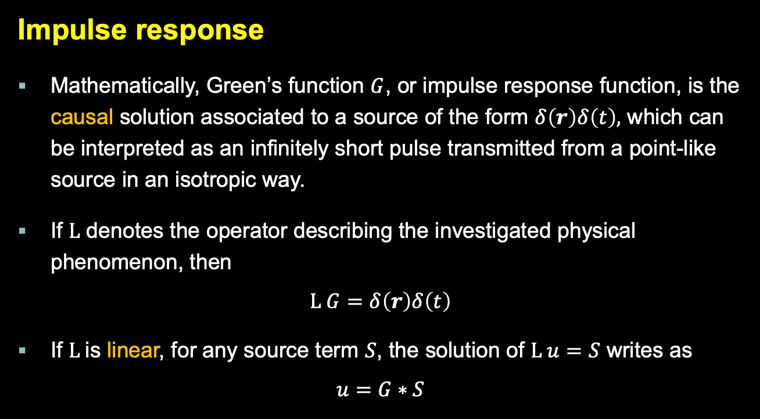
Green’s function
Impulse response
Mathematically, Green’s function $G$, or impulse response function, is the causal solution associated to a source of the form $δ\left(r\right)δ\left(t\right),$ which can be interpreted as an infinitely short pulse transmitted from a point-like source in an isotropic way.
If $L$ denotes the operator describing the investigated physical phenomenon, then
$$L G=δ\left(r\right)δ\left(t\right)$$
If $L$is linear, for any source term $S$, the solution of $L u=S$ writes as
$$u=G∗S$$

Slide 18
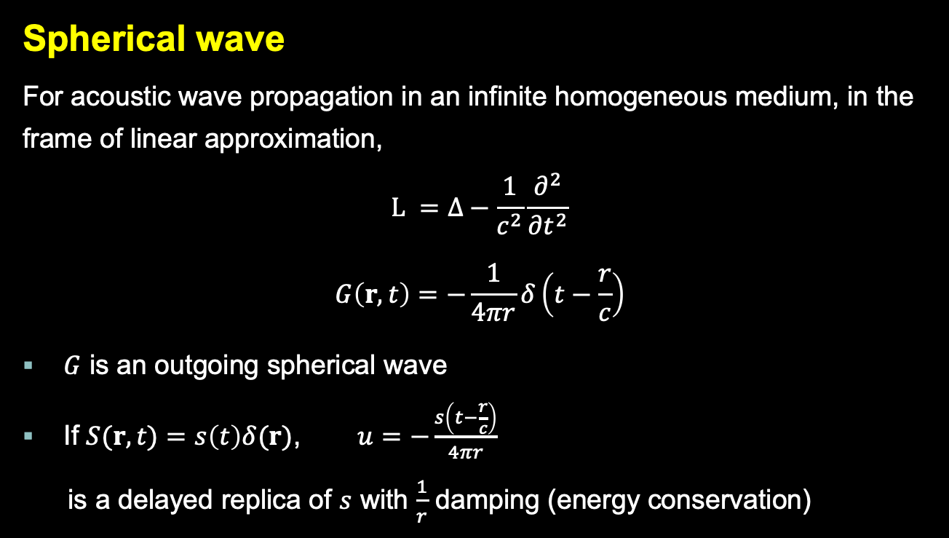
Green’s function
Spherical wave
For acoustic wave propagation in an infinite homogeneous medium, in the frame of linear approximation,
$$L =∆−\frac{1}{c^{2}}\frac{∂^{2}}{∂t^{2}}$$
$$G\left(r,t\right)=−\frac{1}{4πr}δ\left(t−\frac{r}{c}\right)$$
$G$ is an outgoing spherical wave
If $S(r,t)=s\left(t\right)δ(r)$, $u=−\frac{s\left(t−\frac{r}{c}\right)}{4πr}$
is a delayed replica of $s$ with $\frac{1}{r}$ damping (energy conservation)
Notes:
https://www3.nd.edu/~atassi/Teaching/AME%2060633/Notes/fundamentals_w.pdf

Slide 19
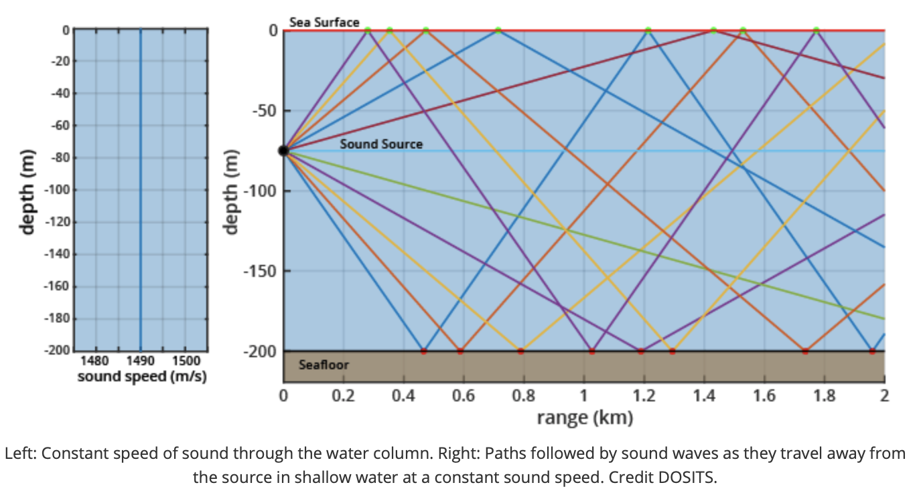
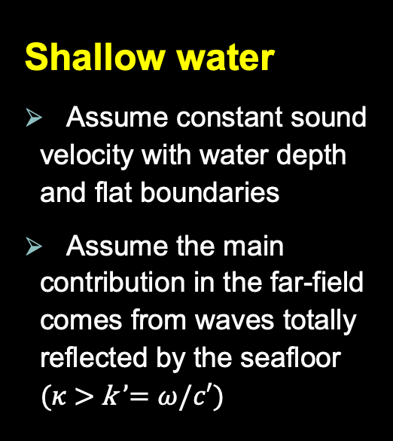
Green’s function
Shallow water
Assume constant sound velocity with water depth and flat boundaries
Assume the main contribution in the far-field comes from waves totally reflected by the seafloor ($κ$> k ’$=ω/c′$)
$G$ is known only for a few (simple) configurations
Notes:
n=0 conduit à q<0, impossible

Slide 20
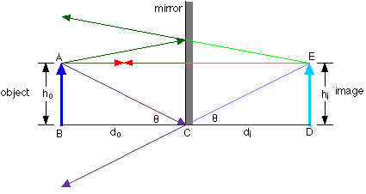
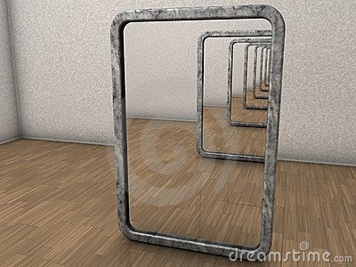
Image through a « mirror »
Here a « mirror » is a flat interface that reflects the rays with r = -1

Slide 21
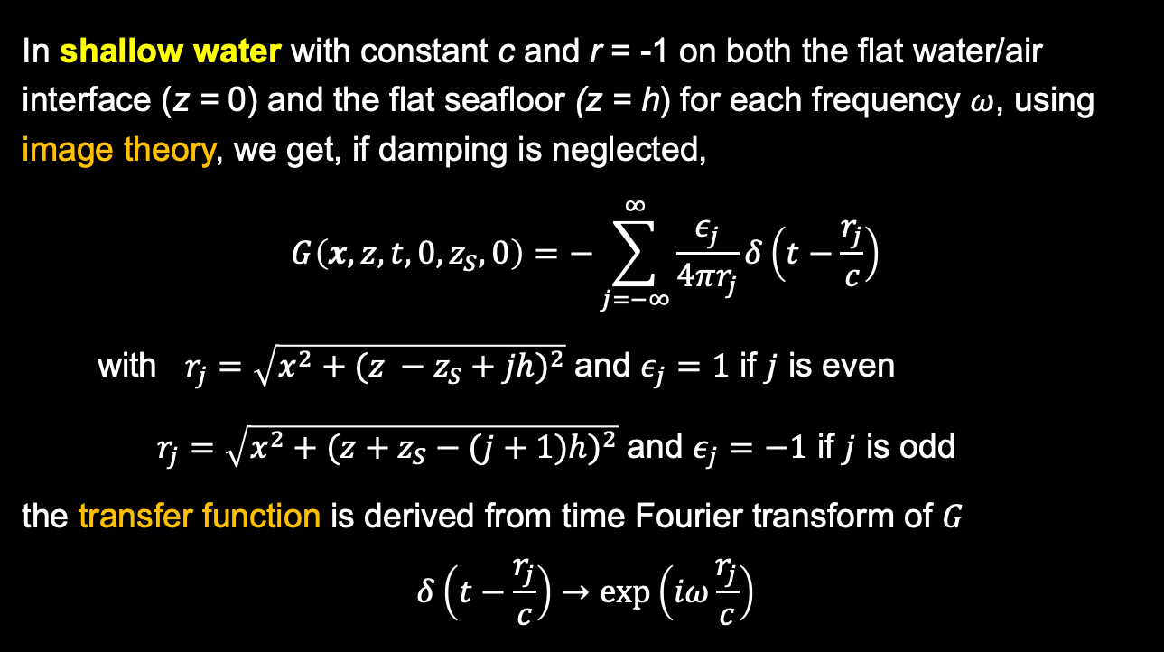
Green’s function
In shallow water with constant c and r = -1 on both the flat water/air interface (z = 0) and the flat seafloor (z = h) for each frequency $ω$, using image theory, we get, if damping is neglected,
$$G\left(x,z,t,0,z_{S},0\right)=−\sum_{j=−∞}^{∞}{\frac{ε_{j}}{4πr_{j}}δ\left(t−\frac{r_{j}}{c}\right)}$$
with $r_{j}=\sqrt{x^{2}+{(z −z_{S}+jh)}^{2}}$ and $ε_{j}=1$ if $j$ is even
$r_{j}=\sqrt{x^{2}+{(z+z_{S}−(j+1)h)}^{2}}$ and $ε_{j}=−1$ if $j$ is odd
the transfer function is derived from time Fourier transform of $G$
$$δ\left(t−\frac{r_{j}}{c}\right)→\exp\left(iω\frac{r_{j}}{c}\right)$$

Slide 22
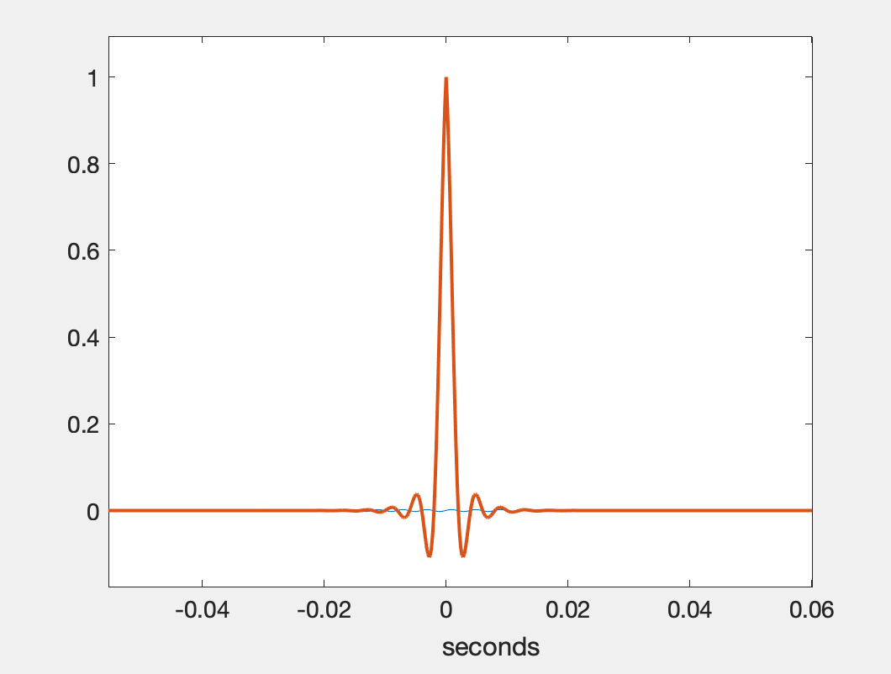
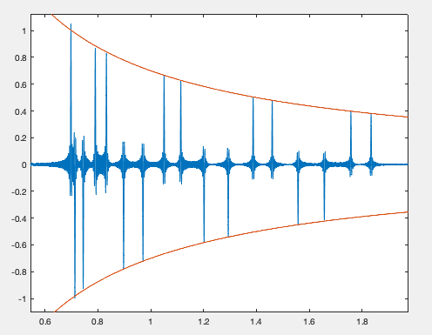
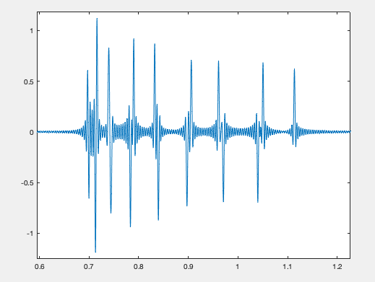
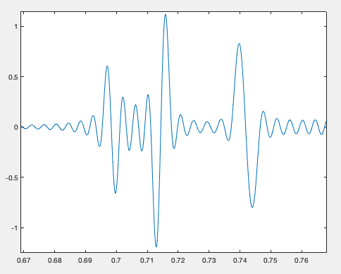
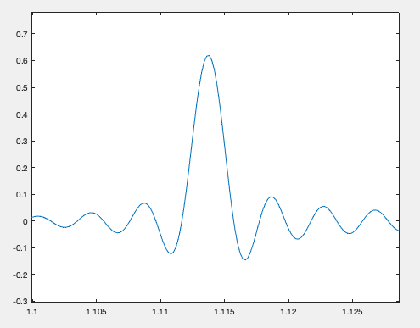

Example of signal
(opposite of the)
Received signal 1 km away in a 350 m depth channel, with 0.6 – 2 s delay.
(no absorption, no noise)
$$s\left(t\right)=\frac{\sin{(πBt)}}{πBt} exp\left(−\frac{B\left|t\right|}{2}\right)$$
B = bandwidth = 500 Hz
1/B = 2 ms
$$r(t)=G_{r_{S},t_{0}}∗s\left(t\right)$$
= $−\sum{\frac{ε_{j}}{4πr_{j}}s\left(t−\frac{r_{j}}{c}\right)}$
The same with 150 m depth
Enlargements

Slide 23
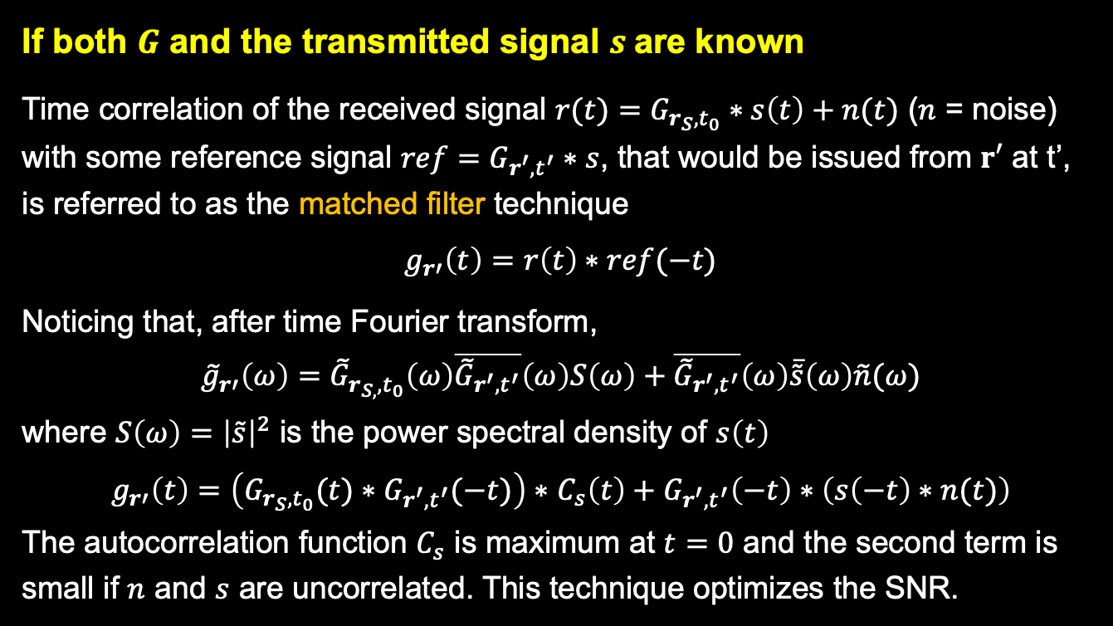
Inverse source problem
If both $G$ and the transmitted signal $s$are known
Time correlation of the received signal $r(t)=G_{r_{S},t_{0}}∗s\left(t\right)+n(t)$ ($n$ = noise)
with some reference signal ${ref=G}_{r^{′},t^{′}}∗s$, that would be issued from $r′$ at t’, is referred to as the matched filter technique
$$g_{r′}\left(t\right)=r\left(t\right)∗ref(−t)$$
Noticing that, after time Fourier transform,
$${\tilde{g}}_{r′}\left(ω\right)={\tilde{G}}_{r_{S,},t_{0}}\left(ω\right)\overline{{\tilde{G}}_{r^{′},t^{′}}}\left(ω\right)S\left(ω\right)+\overline{{\tilde{G}}_{r^{′},t^{′}}}\left(ω\right)\overline{\tilde{s}}\left(ω\right)\tilde{n}(ω)$$
where $S\left(ω\right)={\left|\tilde{s}\right|}^{2}$ is the power spectral density of $s\left(t\right)$
$g_{r′}\left(t\right)=$ $\left(G_{r_{S},t_{0}}(t)∗G_{r^{′},t^{′}}(−t)\right)∗$ $C_{s}\left(t\right)+G_{r^{′},t^{′}}\left(−t\right)∗\left(s\left(−t\right)∗n(t)\right)$
The autocorrelation function $C_{s}$ is maximum at $t=0$ and the second term is small if $n$ and $s$ are uncorrelated. This technique optimizes the SNR.

Slide 24
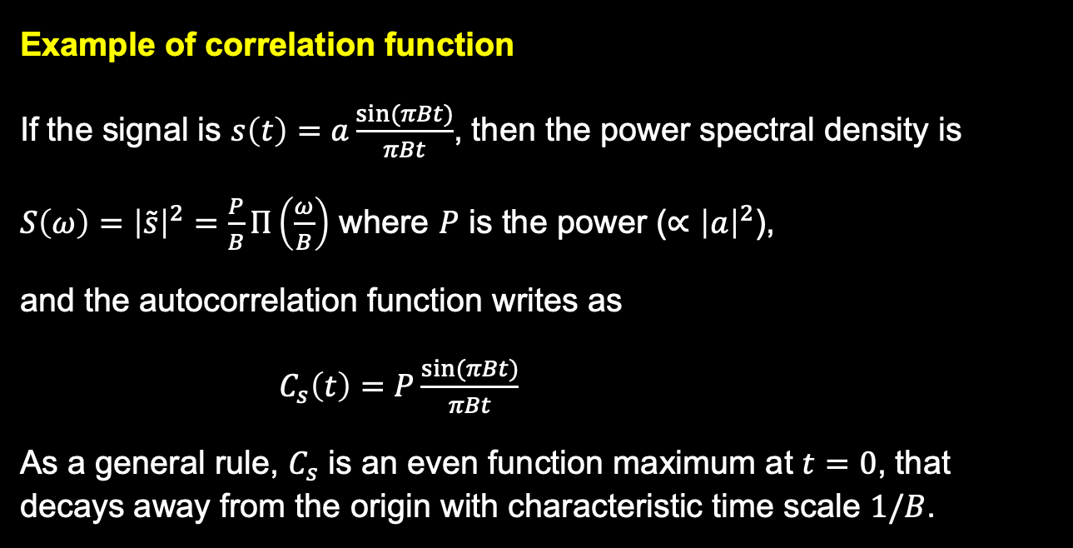
Autocorrelation
Example of correlation function
If the signal is $s\left(t\right)=a\frac{\sin{(πBt)}}{πBt}$, then the power spectral density is
$S\left(ω\right)={\left|\tilde{s}\right|}^{2}=\frac{P}{B}Π\left(\frac{ω}{B}\right)$ where $P$ is the power ($∝{\left|a\right|}^{2}$),
and the autocorrelation function writes as
$C_{s}\left(t\right)=P\frac{\sin{(πBt)}}{πBt}$
As a general rule, $C_{s}$ is an even function maximum at $t=0$, that decays away from the origin with characteristic time scale $1/B$.

Slide 25

Inverse source problem
Matched filter (shallow water)
Since here $G$ writes as a superposition of delayed $δ$ functions, the first term of $g$ is the sum of delayed autocorrelation functions which has its maximum when $r$’ coincides with $r_{S}$ and $t′=t_{0}$
$$\left(G_{r_{S},t_{0}}(t)∗G_{r^{′}}(−t)\right)∗ C_{s}\left(t\right)=\frac{1}{{(4π)}^{2}}\sum_{j,j′}{\frac{ε_{j}ε_{j′}}{r_{j}r_{j′}^{′}}C_{s}\left(t−t_{0}−\frac{r_{j}}{c}+t^{′}+\frac{r_{j^{′}}^{′}}{c}\right)}$$
Therefore, the maximum of the modulus of $g_{r′}$ with respect to $r′$provides the estimation of the location of the source $r_{S}$ and of $t_{0}$
In practice, to remove ambiguities, measurements at several points are required.

Slide 26
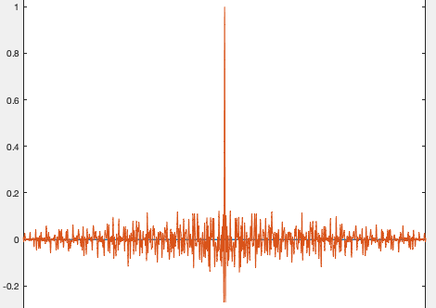
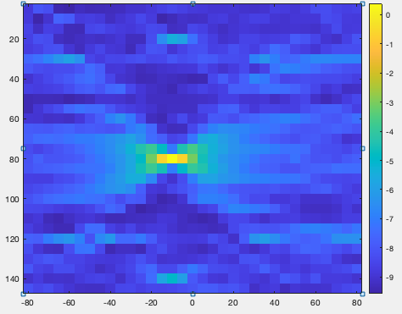
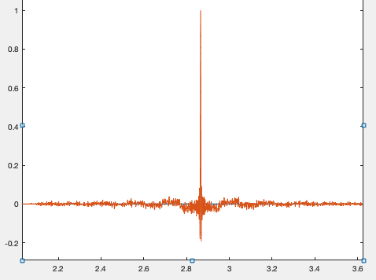
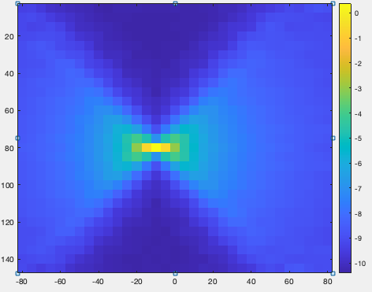

Numerical results
Shallow water
(150 m depth, no noise)
Left:
$g_{r′}\left(t\right)$ when $r′=r_{S}$
Right:
$g_{r′}\left(t_{0}\right)$ (in dB)
when $r^{′}$ is scanning a
150 m x 150 m square
top: 1 receiver
bottom: average over 14 receivers, regularly spaced along a 150 m long vertical line

Slide 27
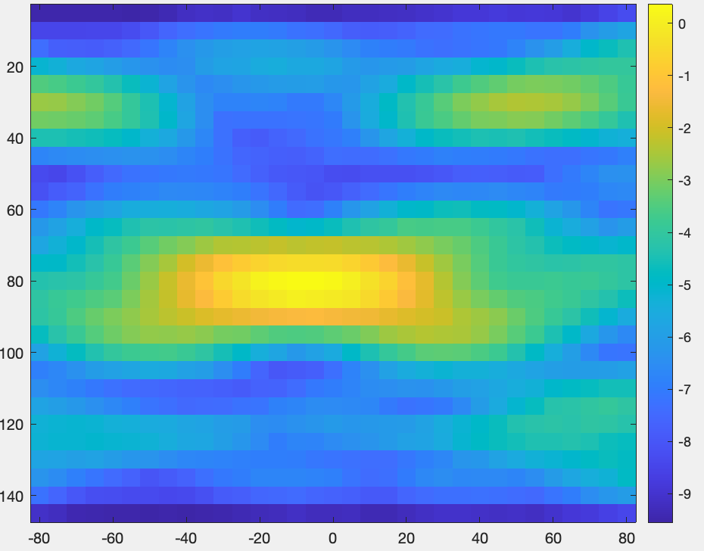
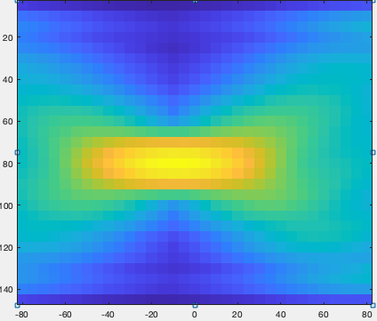


Inverse source problem
Matched filter (continued)
If the frequency bandwidth of the transmitted signal is $B$, the time width of $C_{s}$ is $\frac{1}{B}$. This defines the so-called resolution in time. In the case where $t_{0}$ is known, the resolution in range is $\frac{c}{2B}$
Figure: same as in previous slide (1/14 receivers) with bandwidth
$B=100$Hz (5 times smaller)
To remove ambiguities,
average over multiple receivers.

Slide 28
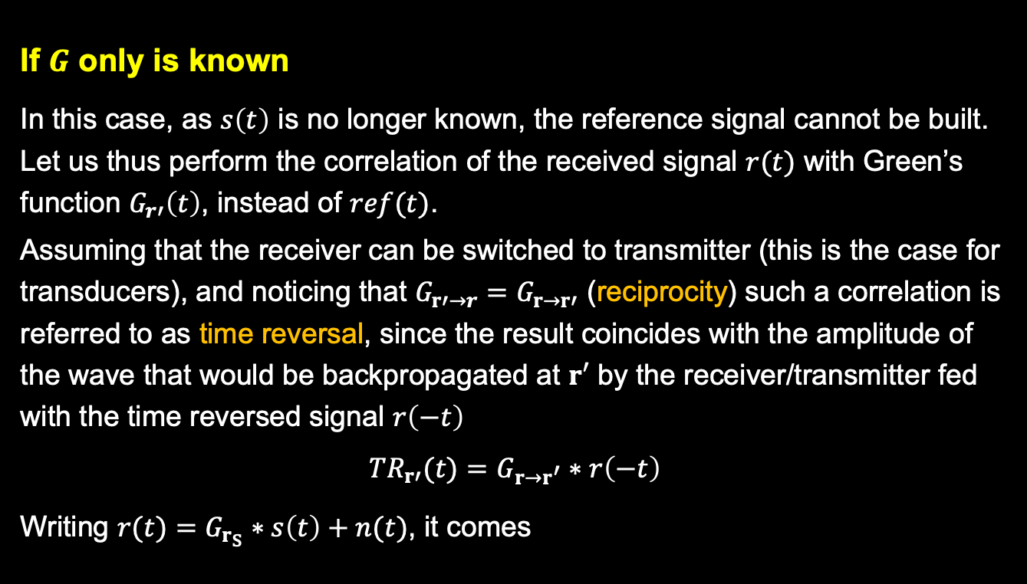
Inverse source problem
If $G$ only is known
In this case, as $s\left(t\right)$ is no longer known, the reference signal cannot be built.
Let us thus perform the correlation of the received signal $r(t)$ with Green’s function $G_{r′}\left(t\right)$, instead of $ref(t)$.
Assuming that the receiver can be switched to transmitter (this is the case for transducers), and noticing that $G_{r′→r}=G_{r→r′}$ (reciprocity) such a correlation is referred to as time reversal, since the result coincides with the amplitude of the wave that would be backpropagated at $r′$ by the receiver/transmitter fed with the time reversed signal $r\left(−t\right)$
$${TR}_{r′}(t)=G_{r→r^{′}}∗r\left(−t\right)$$
Writing $r(t)=G_{r_{S}}∗s\left(t\right)+n(t)$, it comes

Slide 29
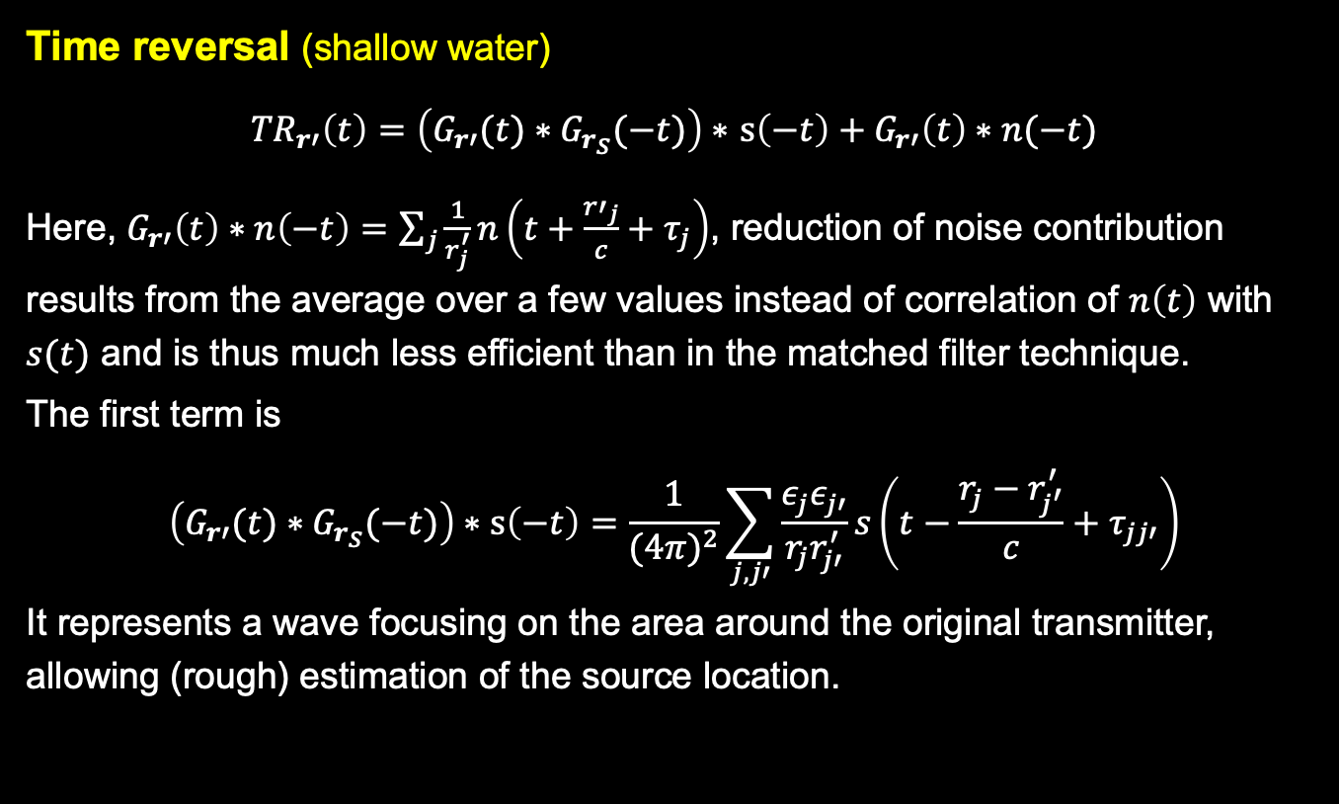
Inverse source problem
Time reversal (shallow water)
${TR}_{r′}\left(t\right)=$ $\left(G_{r′}(t)∗G_{r_{S}}(−t)\right)∗$ $s\left(−t\right)+G_{r′}\left(t\right)∗n(−t)$
Here, $G_{r′}\left(t\right)∗n\left(−t\right)=\sum_{j}{\frac{1}{r_{j}^{′}}n\left(t+\frac{{r′}_{j}}{c}+τ_{j}\right)}$, reduction of noise contribution results from the average over a few values instead of correlation of $n\left(t\right)$ with $s(t)$ and is thus much less efficient than in the matched filter technique.
The first term is
$$\left(G_{r′}(t)∗G_{r_{S}}(−t)\right)∗s\left(−t\right)=\frac{1}{{(4π)}^{2}}\sum_{j,j′}{\frac{ε_{j}ε_{j′}}{r_{j}r_{j′}^{′}}s\left(t−\frac{r_{j}−r_{j^{′}}^{′}}{c}+τ_{jj′}\right)}$$
It represents a wave focusing on the area around the original transmitter, allowing (rough) estimation of the source location.

Slide 30
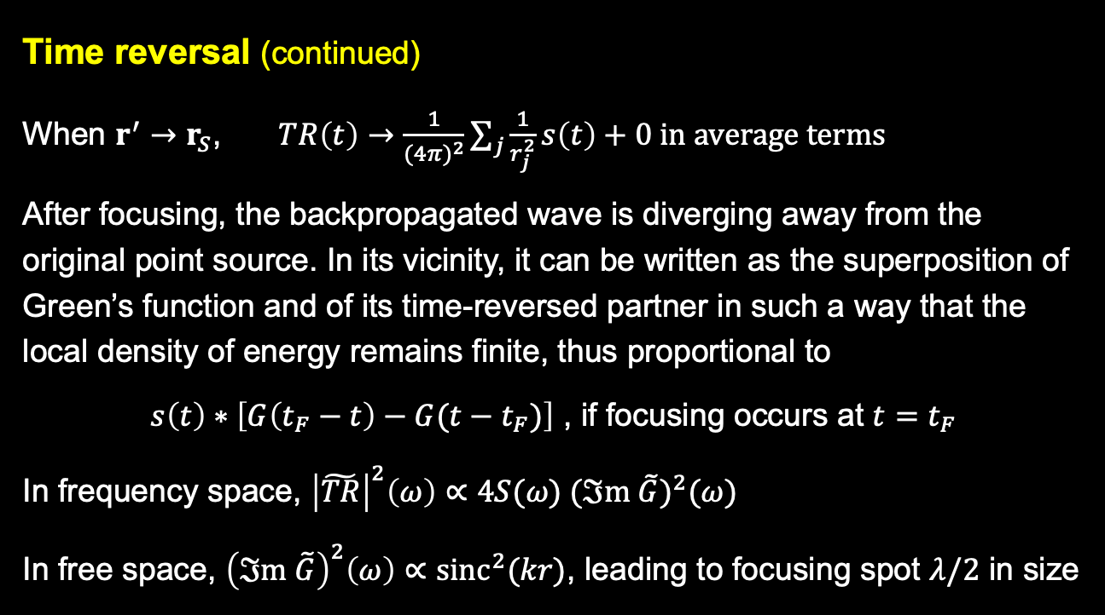
Inverse source problem
Time reversal (continued)
When $r^{′}→r_{S}$, $TR\left(t\right)→\frac{1}{{(4π)}^{2}}\sum_{j}{\frac{1}{r_{j}^{2}}s\left(t\right)}+0 in average terms$
After focusing, the backpropagated wave is diverging away from the original point source. In its vicinity, it can be written as the superposition of Green’s function and of its time-reversed partner in such a way that the local density of energy remains finite, thus proportional to
$s\left(t\right)∗\left[G\left(t_{F}−t\right)−G(t−t_{F})\right]$ , if focusing occurs at $t=t_{F}$
In frequency space, ${\left|\tilde{TR}\right|}^{2}\left(ω\right)∝4S(ω) {(ℑm \tilde{G})}^{2}(ω)$
In free space, ${\left(ℑm \tilde{G}\right)}^{2}\left(ω\right)∝{sinc}^{2}(kr)$, leading to focusing spot $λ/2$ in size

Slide 31
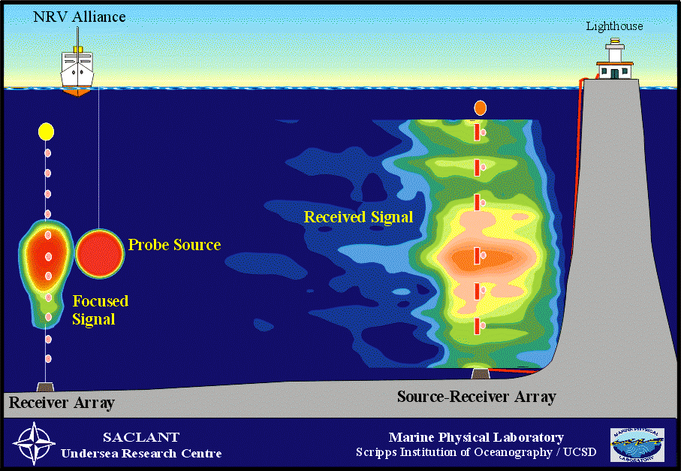
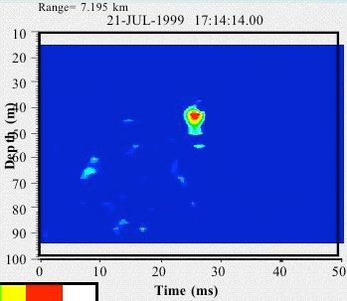
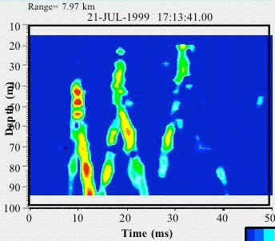


Elba Island Experiment
Focused pulse back at source
TR = last in first out
P. Roux, B Kuperman
Notes:
Pour réaliser expérimentalement le retournement temporel, nul besoin de connaître la fonction de Green. Pour le simuler par contre, nécessaire.

Slide 32

Ambient noise

Slide 33
Extracting coherent information from noise
t
A
correlation
B
t
t
dC/dt ~ G(t) - G(-t)
good estimation of the Green’s function between A and B

Slide 34

Underwater acoustics
1 2
Active source
t
Passive receiver
1 2
Passive receivers
t

Slide 35



Underwater acoustics
NPAL data
Experimental results (70 – 130 Hz)
2.4km
Noise events propagating through receivers 1 and 2 average-up coherently over the long-time in the cross-correlation function.
Coherent wavefronts yield an estimate of the Green’s function between a receiver at depth 500 m in array 1 and all receivers of array 2.
Roux & Kuperman (JASA, 2004), Sabra et al. (JASA, 2005), (IEEE. J. Ocean. Eng. 2005)
Notes:
Note that the correlation processing requires data measurement that have a common clock time. We use data of opportunity from the NPAL program originally taken for
other purposes. Data correspond to different sets of 20 min simultaneous recording of ambient noise on vertical arrays, filtered between 70 and 130 Hz.

Slide 36

Inverse source problem
If neither $G$ nor $s$ are known
The idea here is to take benefit from the noisy underwater environment, by considering noise as a superposition of waves from randomly distributed and uncorrelated sources, to “learn” the medium, i.e. build an approximate $G$.
Let us consider two noise sources located at $r_{i}$, $r_{j}$ and let us correlate the signals received at $r$and $r′$
$$C\left(r ,r^{′},t\right)=C_{ii}+C_{ij}+C_{ji}+C_{jj}$$
with $C_{ii}=N_{i}G\left(r,r_{i},t\right)∗_{t}G({r^{′},r}_{i},−t)$ where $N_{i}$ is noise energy of source $i$
and $C_{ij}=0$ because the noise sources are uncorrelated.
$C_{ii}$ is nothing but the amplitude of the ”noise wave” transmitted from $r$ to $r_{i}$and backpropagated to $r^{′}$. The same for $C_{jj}$ and $r_{j}$.

Slide 37

Noise interferometry
Noise correlation (continued)
The contribution of a set of noise sources to $C$ can thus be considered as that of a time reversal mirror (TRM), sending back the waves from one (surrogate) transmitter to a receiver, leading to
$C\left(t\right)=n\left(t\right)∗\left[G\left(t_{F}−t\right)−G(t−t_{F})\right]$ , if focusing occurs at $t=t_{F}$
However, all noise sources have different characteristics ($n_{i}\left(t\right)≠n_{j}\left(t\right)$), as if the various transducers of the TRM would send back the wave with arbitrary amplitudes.
This uncontrolled parameter does not prevent from using this technique, since the most important here is to reconstruct correctly the time delays resulting from the various paths, more than the true amplitude of the signal (of which $1/t$ decay is known)
Notes:
Le fait que ce soit dC/dt qui donne la fonction de Green n’a aucune importance car que le bruit soin n(t) ou sa primitive ne change rien en pratique.

Slide 38

NTRM (theory)
Notes:
Cas académique: les différentes contributions sont temporellement séparées et la décroissance dans el temps est respectée. En réalité, en particulier si si bande passante étroite, choses moins simples (cf. diapo suivante)

Slide 39


NTRM (in silico)

Slide 40

NTRM (in silico)

Slide 41

NTRM (in silico)

Slide 42


NTRM (in situ)

Slide 43
Noise interforemetry (bibliography)
Ambient noise cross-correlation in free space: Theoretical approach, Roux & al., JASA, 2004
Time reversal of ocean noise, Roux & Kuperman, JASA, 2005
Extracting the local Green’s function on a horizontal array from ambient ocean noise, S.E. Fried & al., JASA Express Letters 2008
Ocean acoustic remote sensing using ambient noise: results from the Florida Straits, M. G. Brown et al., Geophysical Journal International (2016) 206, 574-589
Monitoring deep ocean temperature, K. F. Woolfe et al., GRL 2025
https://www.nature.com/articles/s41598-022-08745-5.pdf
https://www.youtube.com/watch?v=GVxDaaE51cw
DeepGreen: deep learning of Green’s functions for nonlinear boundary value problems, C.R. Gin & al., Scientific Reports, 11, 21614 (2021)
(https://www.nature.com/articles/s41598-021-00773-x)

